Slide 1
Service Fabric Patterns & Best Practices

Slide 2
Service Fabric Continuous Integration and Delivery
Mikkel Mork Hegnhoj

Slide 3
Problem
How do I get on a path of being able to continuously integrate, validate and deliver my code changes in production?
Source Control is usually a no-brainer
Build can somehow be tricky with test and versioning
How do I test and validate in the different stages?
How do I do gradual roll-out my changes to Service Fabric?
How do I handle settings and secrets across environments?
Where do I even start?

Slide 4
Best Practice
Get those pipelines up and running before anything else
Hello World in Azure
Expand with tests and approvals
Expand with stages

Slide 5
Hello World in Azure
Continuous Delivery for Service Fabric with Visual Studio Team Services for Windows

Slide 6
Build and Release flow in VSTS
Repo
Build
Restore
Build
Package
Publish Artifacts
Release
Environment A
Deploy
Environment B
Deploy
Commit

Slide 7
Setting up Continuous Delivery with VSTS

Slide 8
Expand the Pipeline
Better Continuous Delivery for Service Fabric with Visual Studio Team Services for Windows

Slide 9
Build and Release flow in VSTS
Building out the pipeline
Repo
Build
Restore
Build
Package
Publish Artifacts
Release
Deploy
Unit Tests
Run tests
Approve
Environment A
Environment B
Deploy
Run tests
Approve
Commit
Update Versions

Slide 10
Upgrade, Run Tests and Approvals

Slide 11
Publish a Service Fabric Application
Copy Application Package
Register Application
Create Named Application
Application Instance
Application Type and Version
PowerShell and Runtime (FabricClient.ApplicationManagementClient)
SDK → Publish-NewServiceFabricApplication.ps1
Visual Studio Project → Deploy-FabricApplication.ps1
Visual Studio Team Services → Deploy Service Fabric Application

Slide 12
Cluster Upgrade Options
 | Delete & Upload | Rolling Upgrade | VIP Swap | Controlled Migration
Add’l Hardware Costs | None | None | 2x | 1x to 2x
Service availability | Downtime | Reduced scale | Same | Same
Failed upgrade recovery | Downtime until V1 upload | Reduced scale until rollback | Immediate after swap back | Immediate after TM reconfig
V2 testability | Not at all | Not at all | Private & Public | Private & Public
Protocol/Schema change | 1-Phase | 2-Phase | 1-Phase | 1-Phase
Usable with stateful services | No | Yes | No | No
Some upgrades can be done 1 way and
other upgrades another way

Slide 13
Multiple Environments
How to manage settings and secrets across multiple environments

Slide 14
Settings in Service Fabric Services
Visual Studio and Visual Studio Team Services
Application Project
Service Package
  Code
    Service.exe
  Config
    Settings.xml
Application Manifest
<Parameters>
<ServiceManifestImport>
<ConfigOverrides />
</ServiceManifestImport>
Publish
Profiles
  Local.xml
  Test.xml
  Production.xml
Parameter Files
  Local.xml
  Test.xml
  Production.xml
Copy
Register
Create
Publish

Slide 15
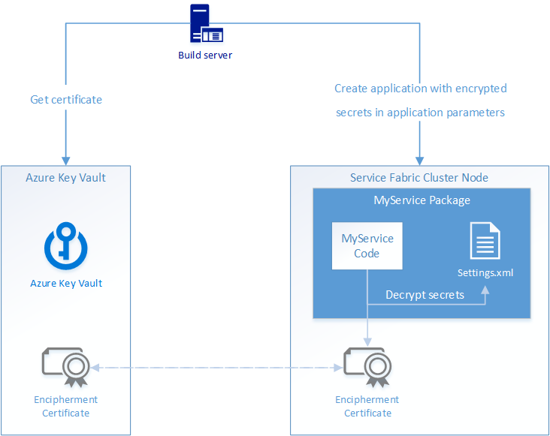
Secrets Management

Slide 16
Deploy an Application with Environment Specific Settings

Slide 17
Large Scale Development
SFNuget and Application Merging

Slide 18
Sharing services and working with Applications across repos
Binary Sharing
Generic purpose service you run as part of your application
Runtime Sharing
Services to be used in a larger application / system
SFNuget
Merging Manifests

Slide 19
SFNuget
Easily package Service Fabric services as NuGet packages
Discover and use reusable services
A Microservices ecosystem
Compose services into applications

Slide 20
SFNuget
Authoring, sharing and using reusable services

Slide 21
Merging Manifests
The master manifest can be used for inner loop or CI.
The master manifest merges other applications, based on individual application manifests and drop locations.
This is an opt-in model, where the current way of doing business can be combined at will.

